Slide 1
Atomic Structure

Slide 2
What is an atom?
Atom: The smallest unit of matter that retains the identity of the substance
First proposed by Democratus

Slide 4
Bohr’s Model
Nucleus
Electron
Orbit
Energy Levels

Slide 5
Atomic Structure
Nucleus
Electron Cloud
Atoms are composed of 2 regions:
  Nucleus: the center of the atom that contains the mass of the atom
  Electron cloud: region that surrounds the nucleus that contains most of the space in the atom
There is 3 subatomic particles in an atom
Electron
Proton
Neutron

Slide 6
What’s in the Nucleus?
The nucleus contains 2 of the 3 subatomic particles:
  Protons: positively charged subatomic particles
  Neutrons: neutrally charged subatomic particles
What’s in the Electron Cloud?
The 3rd subatomic particle resides outside of the nucleus in the electron cloud
  Electron: the subatomic particle with a negative charge and relatively no mass

Slide 7
How do these particles interact?
Protons and neutrons live compacted in the tiny positively charged nucleus accounting for most of the mass of the atom
The negatively charged electrons are small and have a relatively small mass but occupy a large volume of space outside the nucleus

Slide 8
How do the subatomic particles balance each other?
In an atom:
  The number of protons = the number of electrons
    If 20 protons are present in an atom then 20 electrons are there to balance the overall charge of the atom—atoms are neutral
  The neutrons have no charge; therefore they do not have to equal the number of protons or electrons

Slide 9
How do we know the number of subatomic particles in an atom?
Atomic number: this number indicates the number of protons in an atom
  Ex: Hydrogen’s atomic number is 1
    So hydrogen has 1 proton
  Ex: Carbon’s atomic number is 6
    So carbon has 6 protons
**The number of protons identifies the atom.
Ex. 2 protons = He, 29 protons = Cu
Mass number: the number of protons and neutrons in the nucleus
  Ex: hydrogen can have a mass of 3.
  Since it has 1 proton it must have 2 neutrons
  # of neutrons = mass # - atomic #

Slide 10
Determine the number of subatomic particles in the following:
Cl has a mass # of 35 and an atomic # of 17
  p⁺ = 17, nº = 18, e⁻ = 17
K has a mass # of 39 and an atomic # of 19
  P⁺ = 19, nº = 20 e⁻ = 19

Slide 11
Atomic Symbols
Show the name of the element, a hyphen, and the mass number in hyphen notation
sodium-23
Show the mass number and atomic number in nuclear symbol form
mass number
²³ Na
atomic number ¹¹

Slide 12
Isotopes?
Which of the following represent isotopes of the same element? Which element?
²³⁴ _{X} ²³⁴ _{X} ²³⁵ _{X} ²³⁸ _{X}
⁹² ⁹³ ⁹² ⁹²

Slide 13


Learning Check – Counting
Naturally occurring carbon consists of three isotopes, ¹²C, ¹³C, and ¹⁴C. State the number of protons, neutrons, and electrons in each of these carbon atoms.
¹²C ¹³C ¹⁴C
6 6 6
#p⁺ _______ _______ _______
#nº _______ _______ _______
#e⁻ _______ _______ _______

Slide 14
Answers
¹²C ¹³C ¹⁴C
6 6 6
#p⁺ 6 6 6
#nº 6 7 8
#e⁻ 6 6 6

Slide 15
Learning Check
An atom has 14 protons and 20 neutrons.
A. Its atomic number is
1) 14 2) 16 3) 34
B. Its mass number is
1) 14 2) 16 3) 34
C. The element is
1) Si 2) Ca 3) Se
D. Another isotope of this element is
1) ³⁴X 2) ³⁴X 3) ³⁶X
16 14 14

Slide 16
IONS
IONS are atoms or groups of atoms with a positive or negative charge.
Taking away an electron from an atom gives a CATION with a positive charge
Adding an electron to an atom gives an ANION with a negative charge.
To tell the difference between an atom and an ion, look to see if there is a charge in the superscript! Examples: Na⁺ Ca⁺² I⁻ O⁻²
Na Ca I O

Slide 17
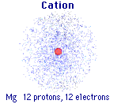
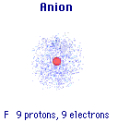
Forming Cations & Anions
A CATION forms when an atom loses one or more electrons.
An ANION forms when an atom gains one or more electrons
Mg --> Mg²⁺ + 2 e-
F + e- --> F⁻

Slide 18
PREDICTING ION CHARGES
In general
metals (Mg) lose electrons ---> cations
nonmetals (F) gain electrons ---> anions

Slide 19
Learning Check – Counting
State the number of protons, neutrons, and electrons in each of these ions.
³⁹ K⁺ ¹⁶O ⁻² ⁴¹Ca ⁺²
19 8 20
#p⁺ ______ ______ _______
#nº ______ ______ _______
#e⁻ ______ ______ _______

Slide 20
One Last Learning Check
Write the nuclear symbol form for the following atoms or ions:
A. 8 p⁺, 8 n, 8 e⁻ ___________
B. 17p⁺, 20n, 17e⁻ ___________
C. 47p⁺, 60 n, 46 e⁻ ___________

Slide 21
How exactly are the particles arranged?
Bohr Model of the atom:
Reviewers think this could lead to misconceptions!
All of the protons and the neutrons
The 3rd ring can hold up to 18 e⁻
The 1st ring can hold up to 2 e⁻
The 4th ring and any after can hold up to 32 e⁻
The 2nd ring can hold up to 8 e⁻

Slide 22
What does carbon look like?
Mass # = 12 atomic # = 6
p⁺ = 6 nº = 6 e⁻ = 6
6 p and 6 n live in the nucleus

Slide 23
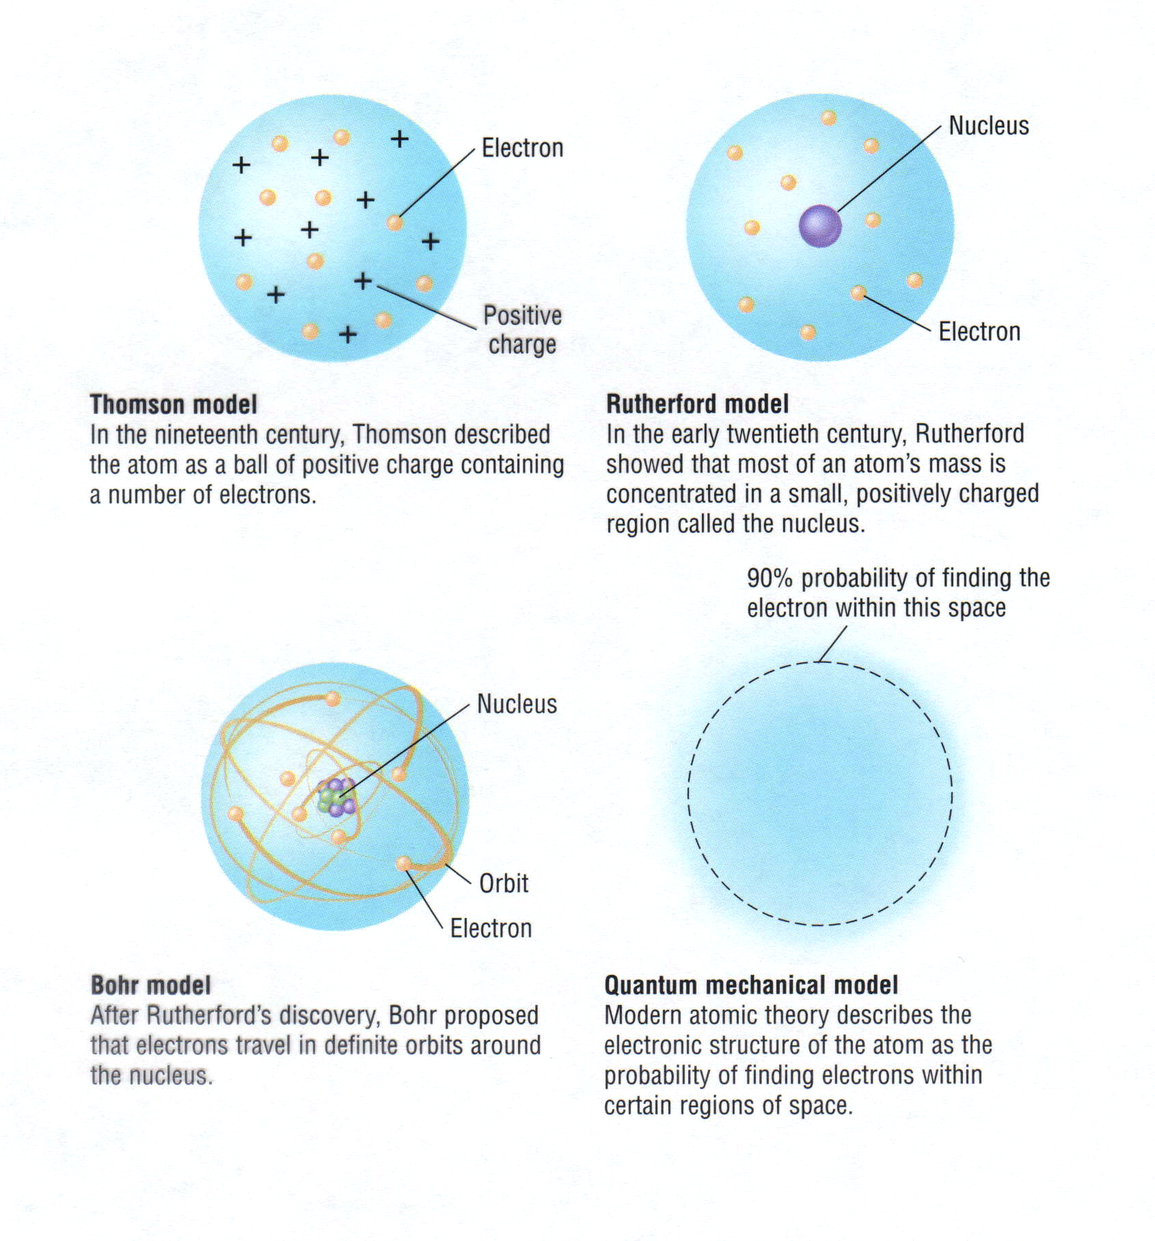
Development of Atomic Models
Thomson model
In the nineteenth century, Thomson described
the atom as a ball of positive charge containing
a number of electrons.
Rutherford model
In the early twentieth century, Rutherford
showed that most of an atom's mass is
concentrated in a small, positively charged
region called the nucleus.
Bohr model
After Rutherford's discovery, Bohr proposed
that electrons travel in definite orbits around
the nucleus.
Quantum mechanical model
Modern atomic theory described the
electronic structure of the atom as the
probability of finding electrons within
certain regions of space.

Slide 24
The Bohr atomic model
The Bohr model was a one-dimensional model that used one quantum number to describe the distribution of electrons in the atom.
This quantum number represents only size of the orbit, which was described by the n quantum number.

Slide 25
Schrowdinger's model allowed the electron to occupy three-dimensional space. It therefore required three coordinates, or three quantum numbers, to describe the orbitals in which electrons can be found.

Slide 26
Quantum number
Four numbers are used to describe completely the movement and trajectories of each electron within an atom.

Slide 27
Principle Quantum Number “n”
The principle quantum number (n) indicates the main energy level occupied by the electron (Size)
  n can have integral values of 1, 2, 3, etc.

Slide 28
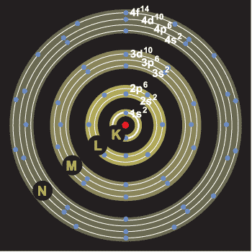
MULTIELECTRON ATOMS

Slide 29
Azimuthal Quantum Number
The angular momentum (or azimuthal) quantum number (symbolized by “l “) indicates the shape of the orbital
  “l “ can take on integral values from
  0 to n -1, for each value of n

Slide 30
Which sublevel does each value of “l” represent?
P. Number Value of l letter used
n=1 0 s
n=2 0 1 s p
n=3 0 1 2 s p d
n=4 0 1 2 3 s p d f

Slide 31
Magnetic Quantum Number
The magnetic quantum number (m_{l}) describes the orientation of the orbital in space
  It can take on values from “l to –l”
  For example:
  If “l ” is 2 then m_{l} could be 2, 1, 0, -1, -2

Slide 32
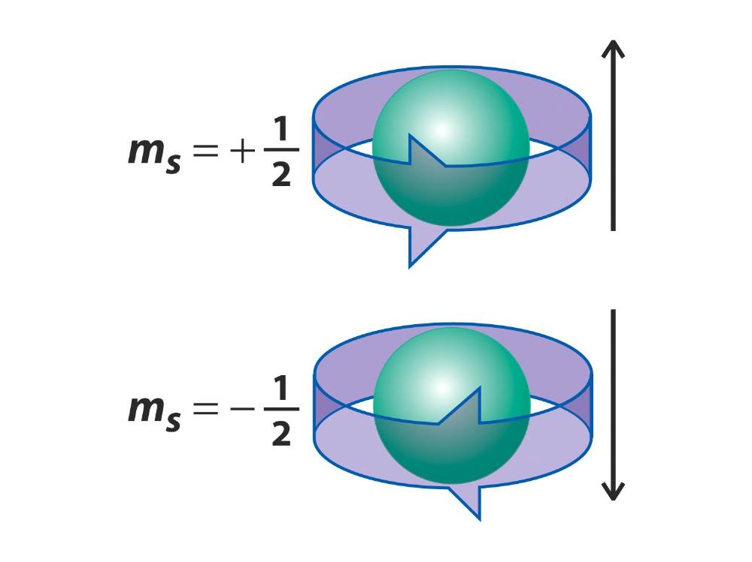
Electron Spin Quantum Number
The fourth quantum number: Electron Spin (m_{s})
m_{s} = +1/2 (spin up) or -1/2 (spin down)
Spin is a fundamental property of electrons, like its charge and mass.

Slide 33
Electron Configurations
5.2
The ways in which electrons are arranged in various orbitals around the nuclei of atoms are called electron configurations.
  Three rules—the Aufbau principle,
  Pauli exclusion principle,
  Hund’s rule
  tell you how to find the electron configurations of atoms.

Slide 34
Atomic Orbitals
5.1
The numbers and kinds of atomic orbitals depend on the energy sublevel.
Energy Level, n | # of sublevels | Letter of sublevels | # of orbitals per sublevel | # of electrons in each orbital | Total electrons in energy level
1 | 1 | s | 1 | 2 | 2
2 | 2 | s p | 1 3 | 2 6 | 8
3 | 3 | s p d | 1 3 5 | 2 6 10 | 18
4 | 4 | s p d f | 1 3 5 7 | 2 6 10 14 | 32

Slide 35
Aufbau principle
The aufbau principle states that in the ground state of an atom or ion, electrons fill atomic orbitals of the lowest available energy levels before occupying higher levels.
The maximum number of electrons in any shell is 2n², where n is the principal quantum number. The maximum number of electrons in a subshell (s, p, d or f) is equal to 2(2ℓ+1) where ℓ = 0, 1, 2, 3... Thus these subshells can have a maximum of 2, 6, 10 and 14 electrons respectively. In the ground state the electronic configuration can be built up by placing electrons in the lowest available orbitals until the total number of electrons added is equal to the atomic number.
Ti (Z = 22) 1s² 2s² 2p⁶ 3s² 3p⁶ 3d² 4s².
1. Electrons are assigned to orbitals in order of increasing value of (n+ℓ).
  2. For subshells with the same value of (n+ℓ), electrons are assigned first to the sub shell with lower n.

Slide 36
Hund’s Rule: An atomic orbital may describe at most two electrons, at least one for that orbital to exist. To occupy the same orbital, two electrons must have opposite spins. If two electrons occupy the same orbital they are said to be paired. Orbital's with one electron are unpaired.
Pauli Exclusion Principle: When electrons occupy orbital's of equal energy, one electron enters each orbital until all the orbital's contain one electron, with spins parallel, before they are paired. Second electrons then add to each orbital so that their spins are paired.

Slide 37
Electron Configuration Practice
Write a ground state electron configuration for a neutral atom
K
Ne

Slide 38
Electron Configuration Practice
Write a ground state electron configuration for these ions.
O²⁻
Na⁺

Slide 39
The Bohr Model
Each electron has a fixed energy = an energy level.
  Electrons can jump from one energy level to another.
  Electrons can not be or exist between energy levels.
A quantum of energy is the amount of energy needed to move an electron from one energy level to another energy level.
To move from one level to another, the electron must gain or lose the right amount of energy.
The higher the energy level, the far it is from the nucleus.
  Gain energy to move to higher energy levels (away from nucleus)
  Lose energy to move to lower energy levels (closer to nucleus)

Slide 40
Bohr Model of Atom
Increasing energy
of orbits
n = 3
e⁻
n = 2
e⁻
e⁻
e⁻
n = 1
e⁻
e⁻
e⁻
e⁻
e⁻
e⁻
e⁻
A photon is emitted
with energy E = hf
The Bohr model of the atom, like many ideas in
the history of science, was at first prompted by
and later partially disproved by experimentation.
Notes:
In 1913, Niels Bohr proposed a theoretical model for the hydrogen atom that explained its emission spectrum.
– His model required only one assumption: The electron moves around the nucleus in circular orbits that can have only certain allowed radii.
– Bohr proposed that the electron could occupy only certain regions of space
– Bohr showed that the energy of an electron in a particular orbit is
E_{n} = – ℜhc
n²
where ℜ is the Rydberg constant, h is the Planck’s constant, c is the speed of light, and n is a positive integer corresponding to the number assigned to the orbit.
n = 1 corresponds to the orbit closest to the nucleus and is the lowest in energy.
A hydrogen atom in this orbit is called the ground state, the most stable arrangement for a hydrogen atom.
As n increases, the radii of the orbit increases and the energy of that orbit becomes less negative.
A hydrogen atom with an electron in an orbit with n >1 is in an excited state — energy is higher than the energy of the ground state.
Decay is when an atom in an excited state undergoes a transition to the ground state — loses energy by emitting a photon whose energy corresponds to the difference in energy between the two states.

Slide 41
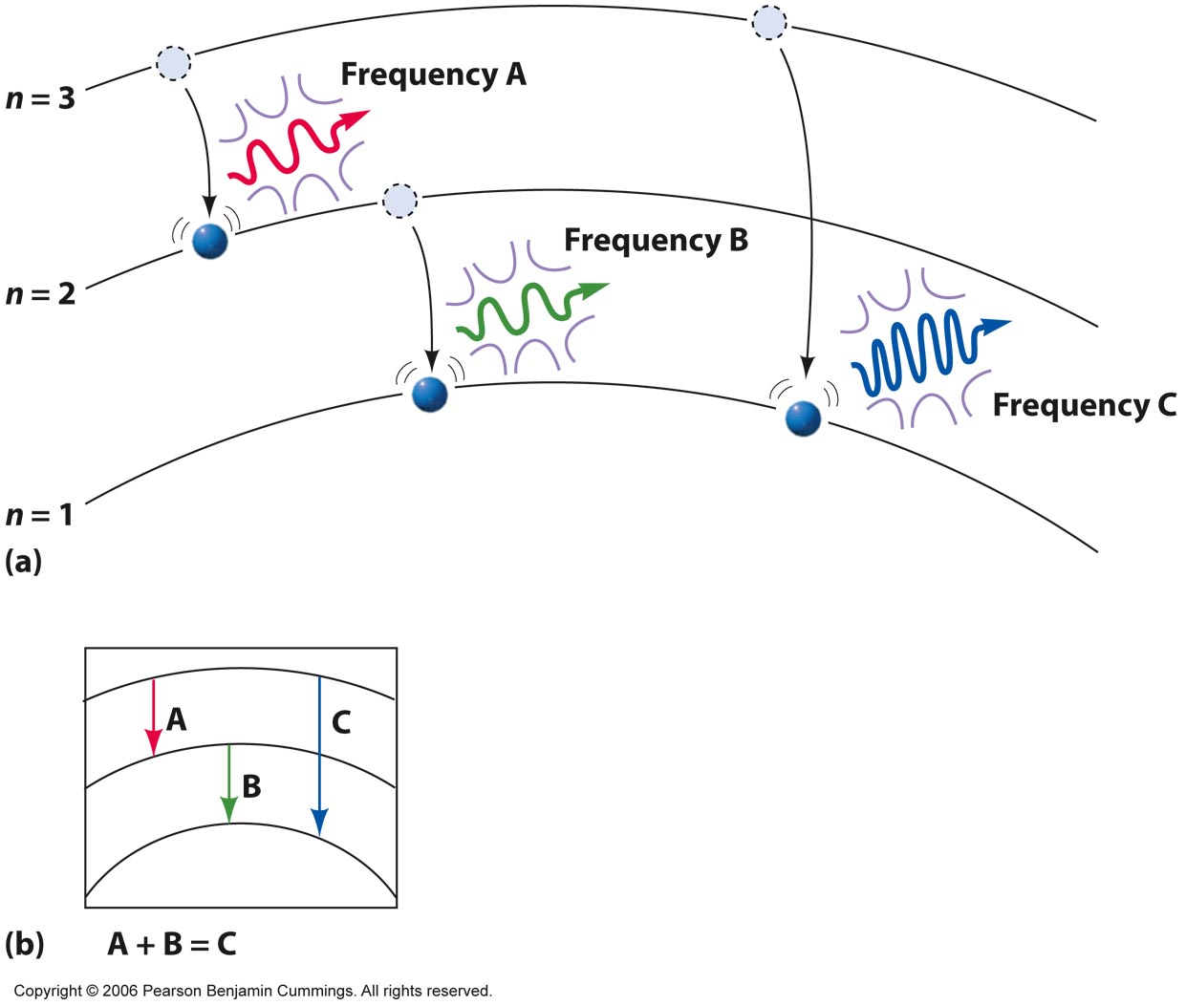
The degree to which they move from level to level determines the frequency of light they give off.
Notes:
Figure 5-14

Slide 42

The Bohr Model
The amount of energy required to go from one energy level to another is the not same for the electrons.
Higher energy levels are closer together. This means it takes less energy to change levels in the higher energy levels.
Limitation:
The Bohr model was a great step of the new quantum theory,
but it had its limitations.
Works only to single-electron atoms.
Could not account for the intensities or the fine structure of the spectral lines.
Could not explain the binding of atoms into molecules.

Slide 43
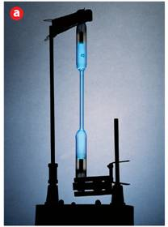
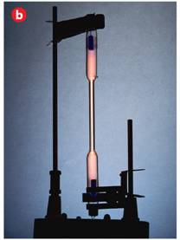
Did you know that an element can be identified by its emission spectra?
  When atoms absorb energy, electrons move into higher energy levels. These electrons then lose energy by emitting light when they return to lower energy levels.
Mercury
Nitrogen

Slide 44
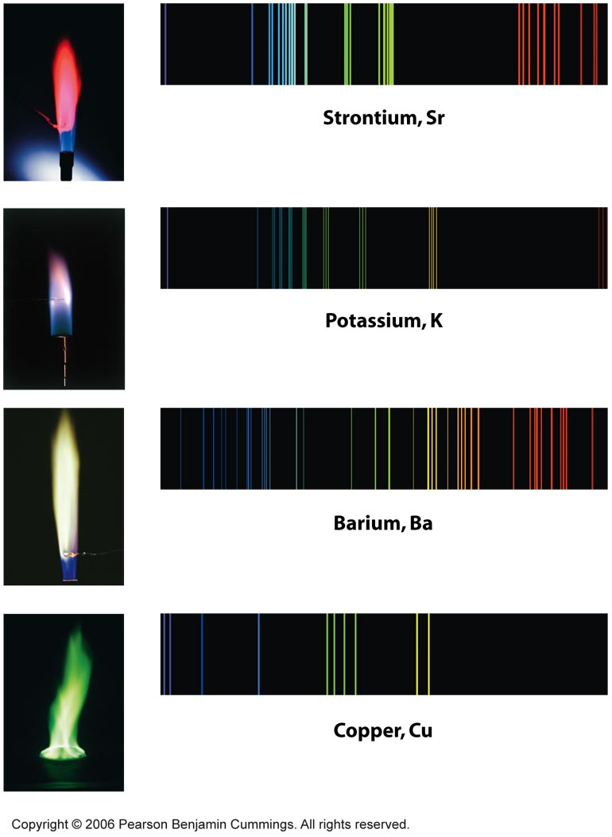
Fingerprints of certain atoms
Notes:
Figure 5-8

Slide 45
An Explanation of Atomic Spectra
5.3
    In the Bohr model, the lone electron in the hydrogen atom can have only certain specific energies.
      A quantum of energy in the form of light is emitted when the electron drops back to a lower energy level.

Slide 46
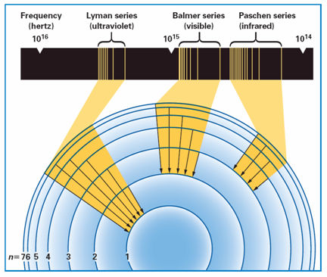
An Explanation of Atomic Spectra
5.3
    The three groups of lines in the hydrogen spectrum correspond to the transition of electrons from higher energy levels to lower energy levels.
Notes:
The three groups of lines in the hydrogen spectrum correspond to the transition of electrons from higher energy levels to lower energy levels. The Lyman series corresponds to the transition to the n = 1 energy level. The Balmer series corresponds to the transition to the n = 2 energy level. The Paschen series corresponds to the transition to the n = 3 energy level.

Slide 47
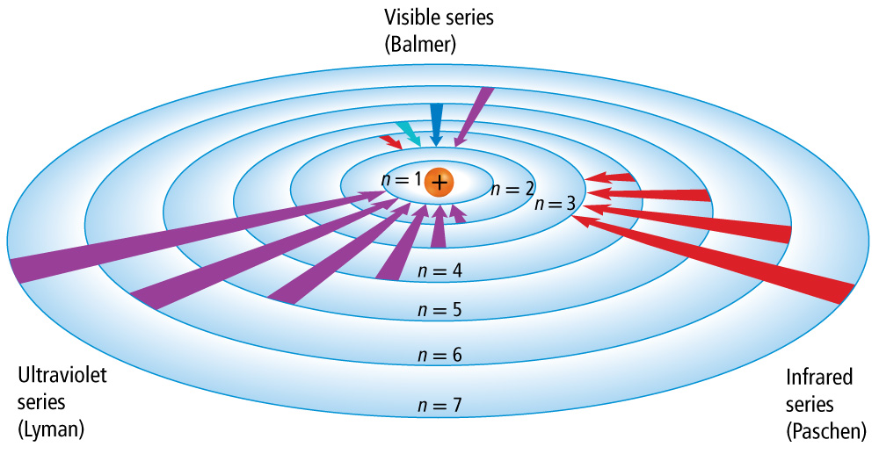
Bohr’s Model

Slide 48
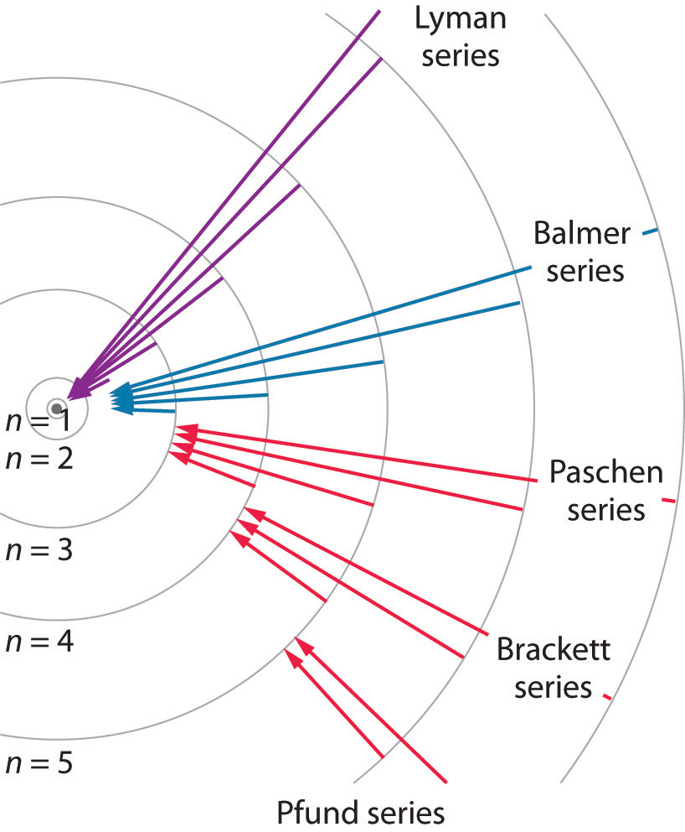

Slide 49
MULTIELECTRON ATOMS

Slide 50
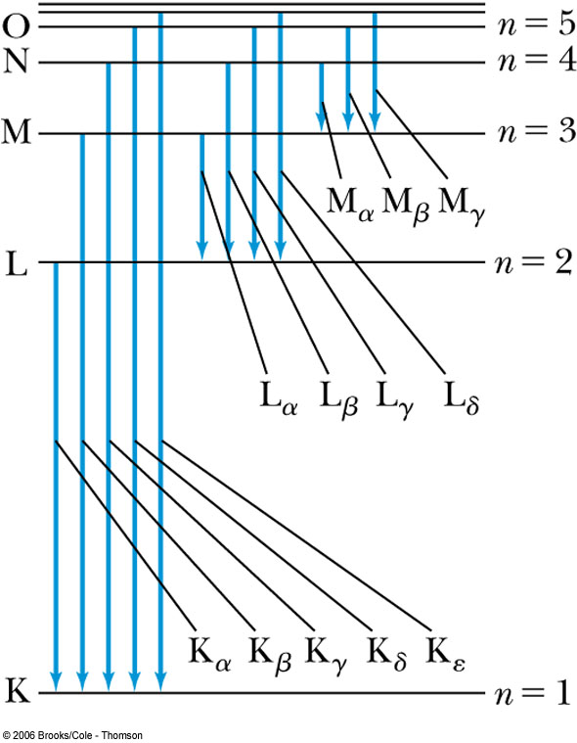
Characteristic X-Ray Spectra and Atomic Number
Shells have letter names:
K shell for n = 1
L shell for n = 2
The atom is most stable in its
ground state.
When it occurs in a heavy atom, the radiation emitted is an X-ray.
It has the energy E (X-ray) = E_{u} − E_{ℓ}.
An electron from higher
shells will fill the inner-shell vacancy at lower energy.

Slide 51
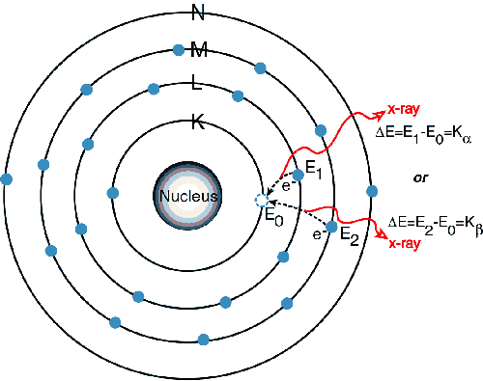
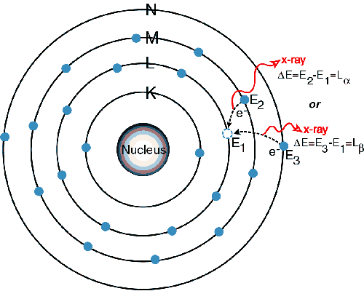
Extension of Bohr Theory to X-rays
.
http://amptek.com/xrf/

Slide 52
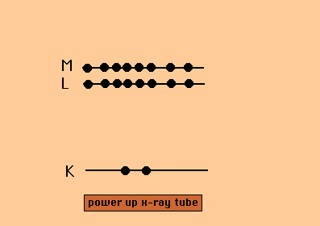
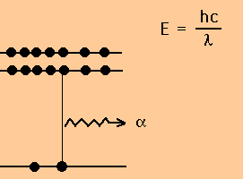
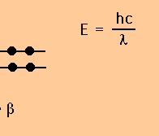
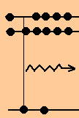
X-rays
Mechanism
Decelerating charges give off radiation

Slide 53
X-rays
Mechanism
Decelerating charges give off radiation

